Slide 1
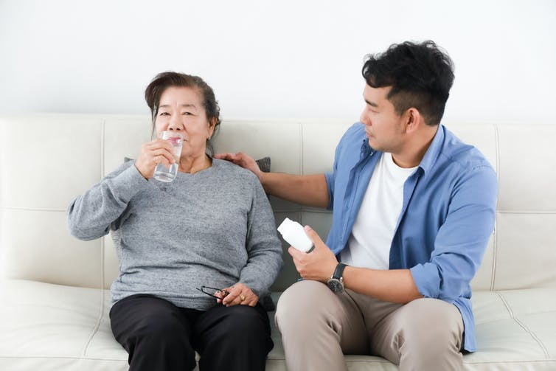

Caregiving

Slide 2
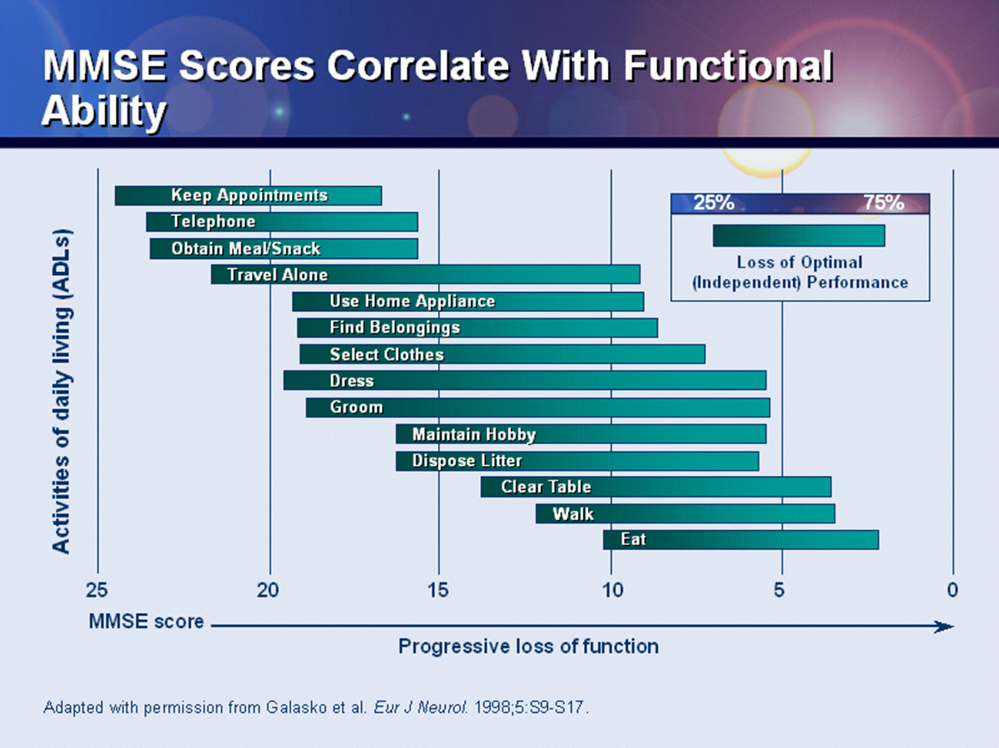

Slide 3

Caregiving - Information
Medical Appointments
Have an updated list of medications (doses and what they are for)
Keep a diary of symptoms/behavior
    What are the symptoms/behaviors?
    When do they occur?
    How bothersome are they?
    What triggers them?
    What seems to help?
    What makes things worse?

Slide 4
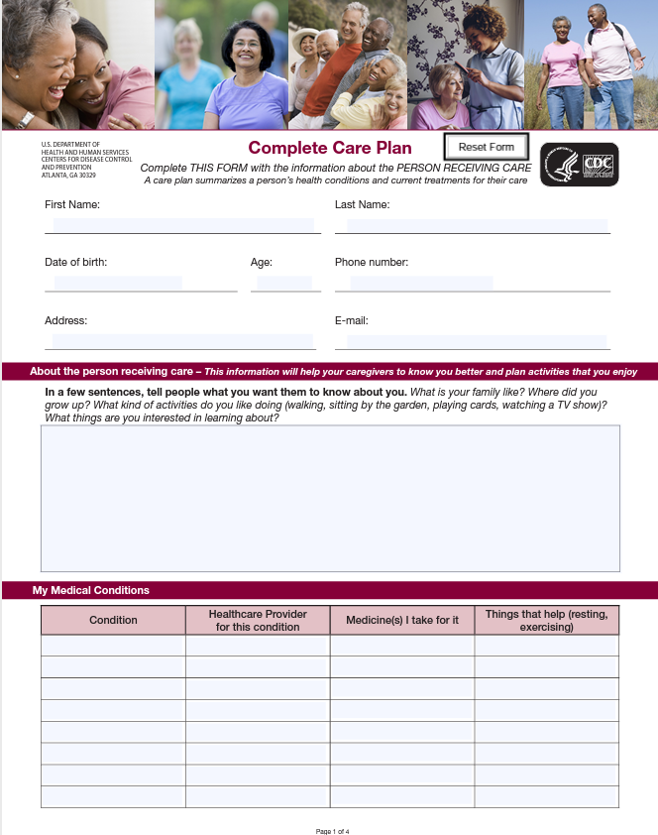
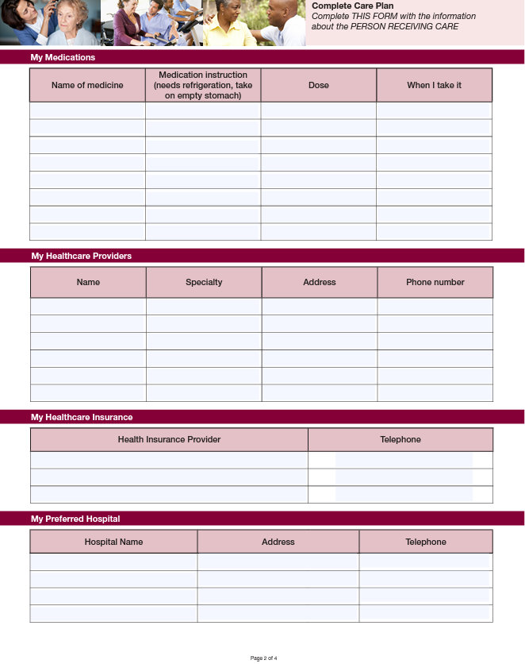
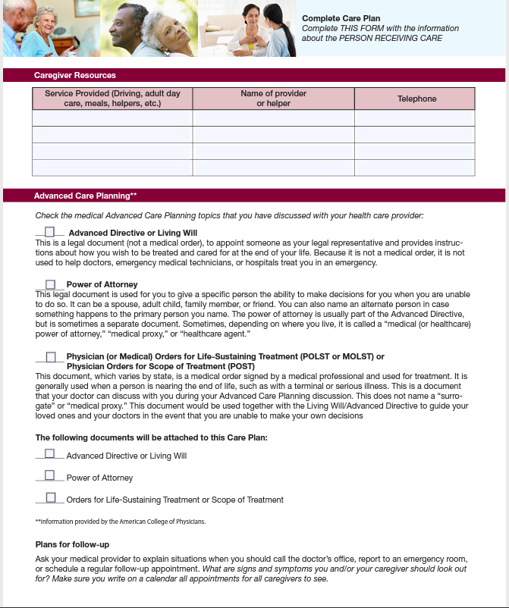
Care Plan
www.cdc.gov/aging/caregiving/pdf/complete-care-plan-form-508.pdf

Slide 5







Self Care
Notes:
Staying active, Doing activities you enjoy, keep learning, Take deep breaths, Stress relief ( Scream, stomp, cry, laugh whatever works for you) Try to get good sleep, Eat healthy as you can, and stay social (support groups, time with friends, family ( use respite if needed)

Slide 6
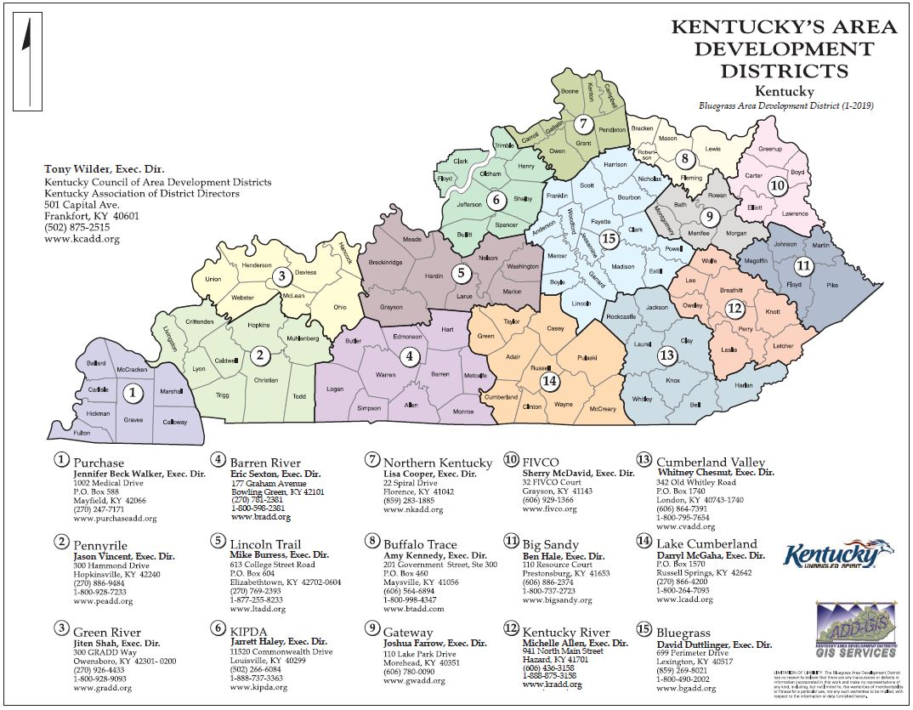
Resources
Area Agency on Aging
https://chfs.ky.gov/agencies/dail/Pages/aaail.aspx
Caregiver support services
Ombudsmen
Aging and Disability Resource Center
Nutrition Sites
And more

Slide 7
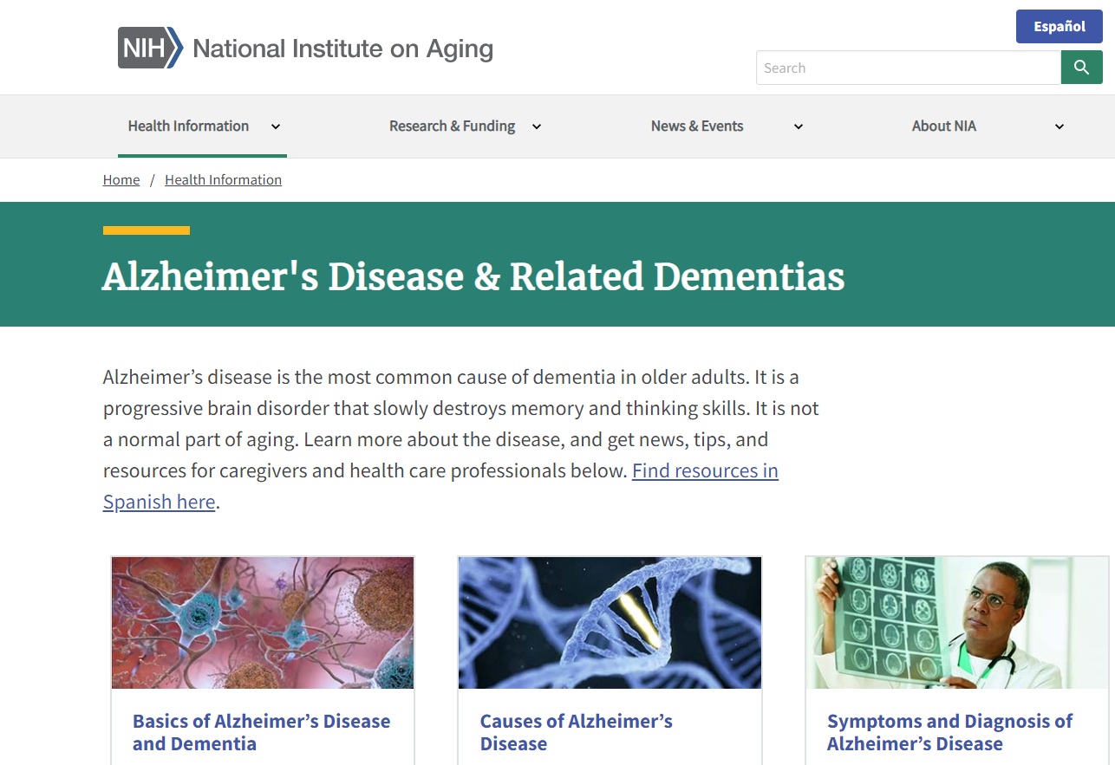
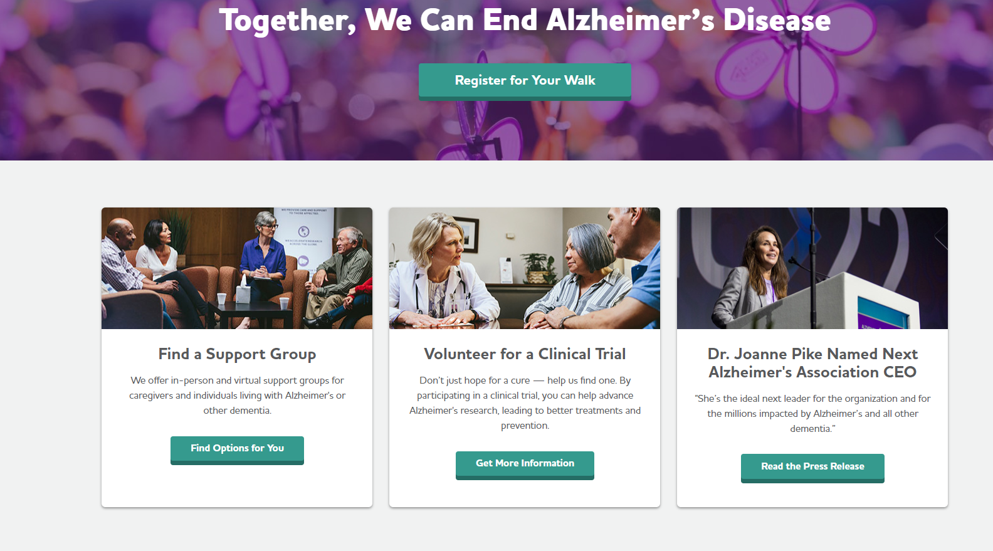
Resources
www.alz.org
https://www.nia.nih.gov/

Slide 8
Questions?
Comments & Concerns
You can also email us:
Sarah Hatch, MSW seha280@uky.edu
Kelly Parsons, MSW krkaze0@uky.edu

